Slide 1
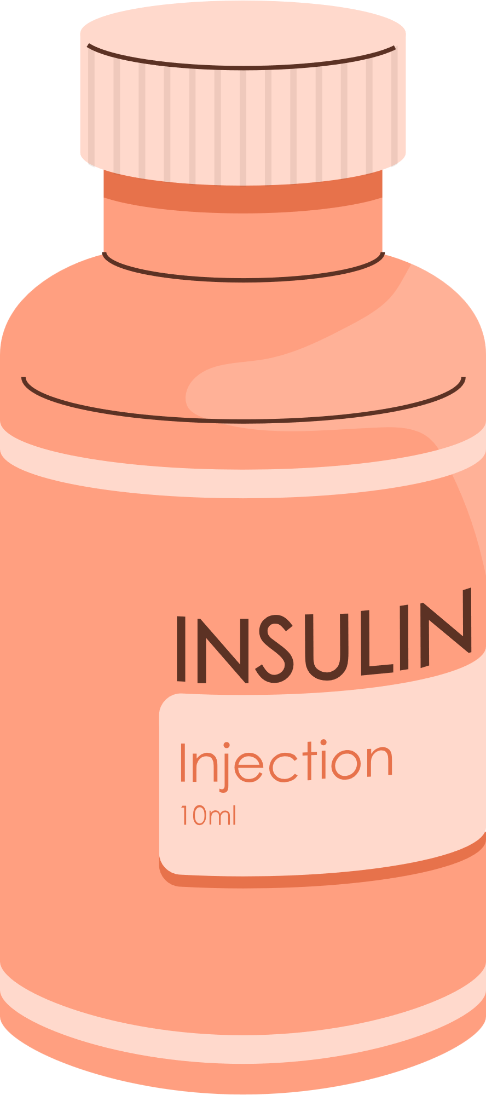


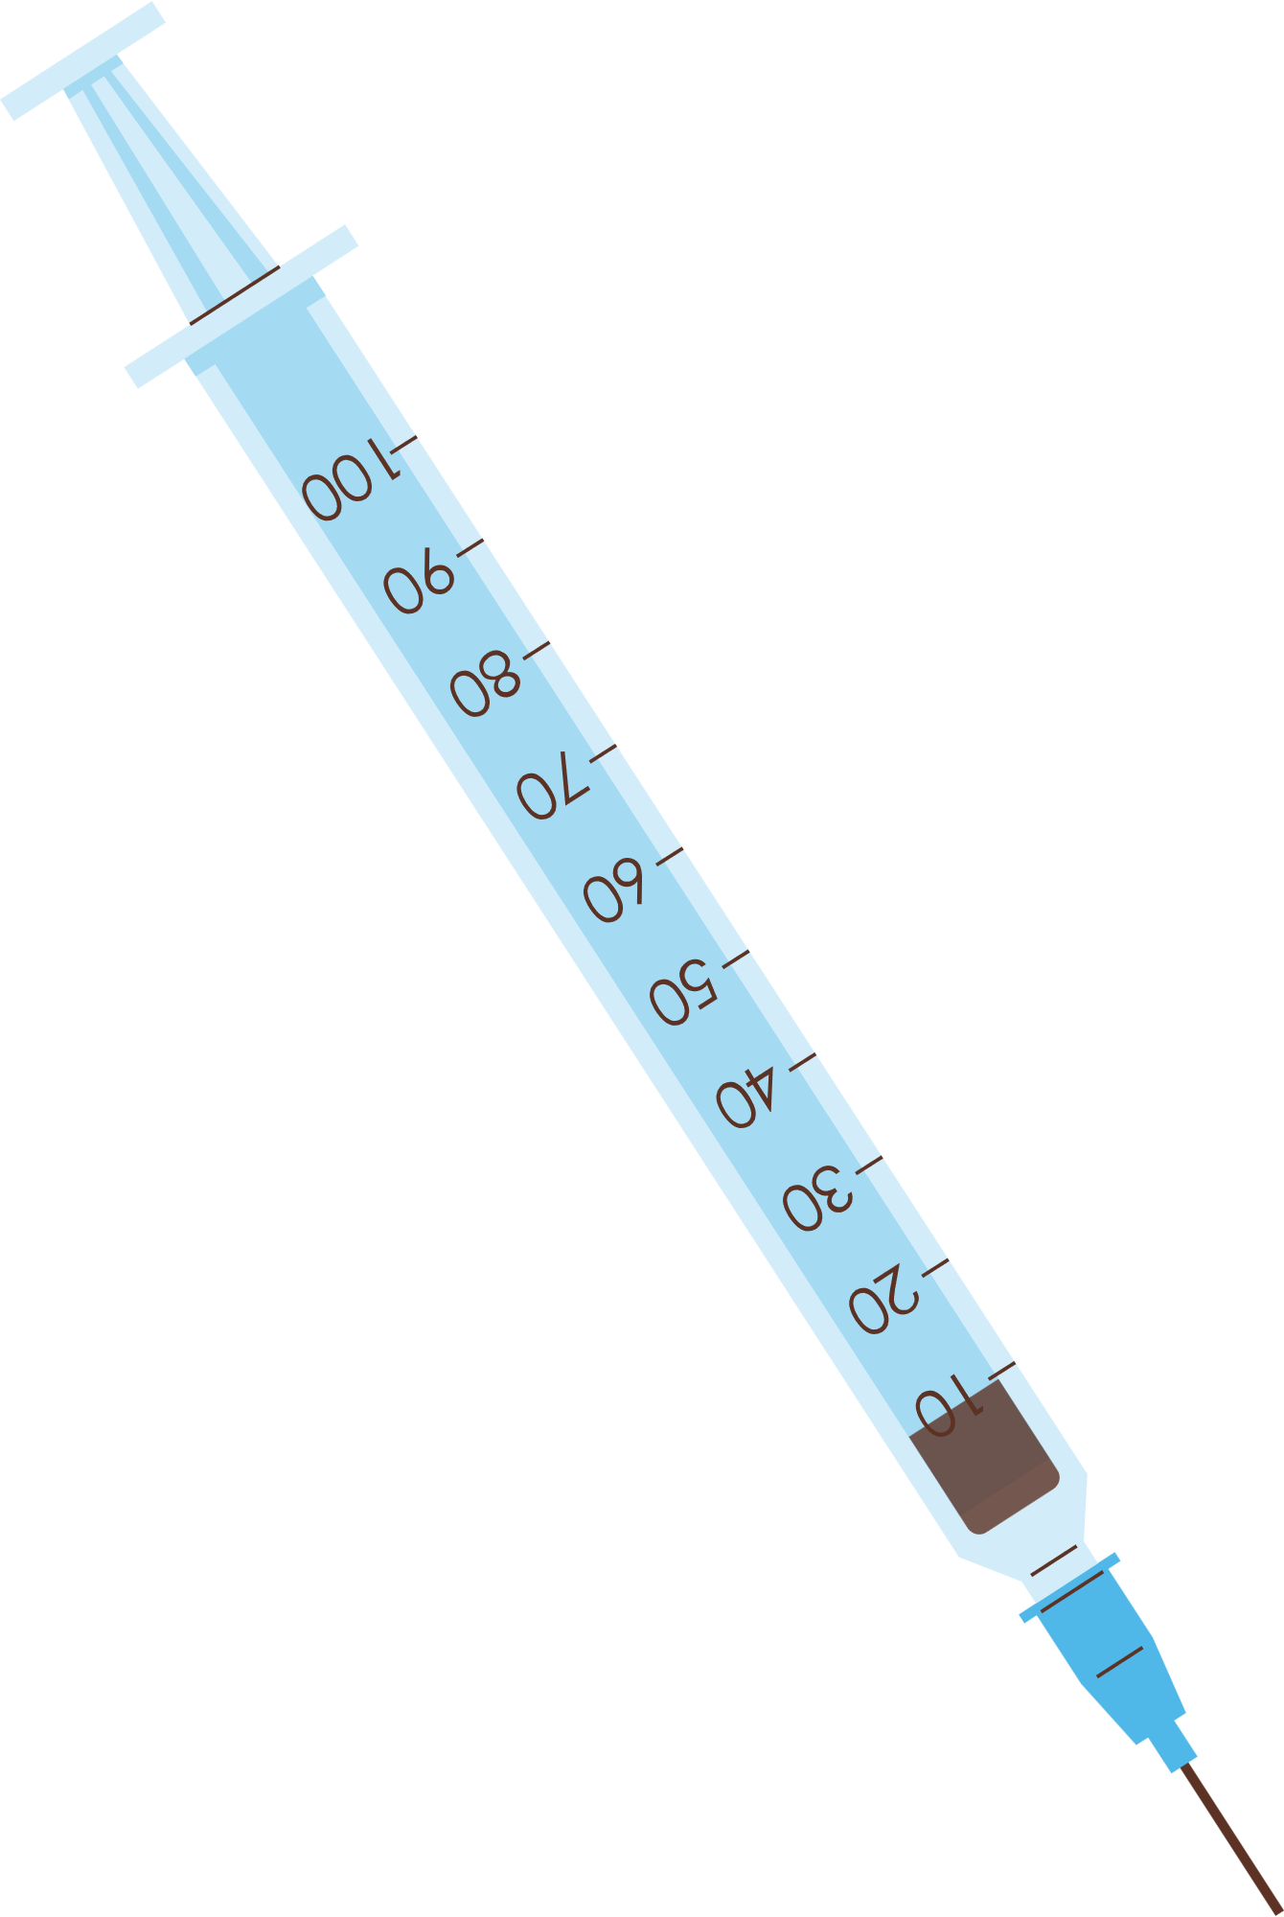
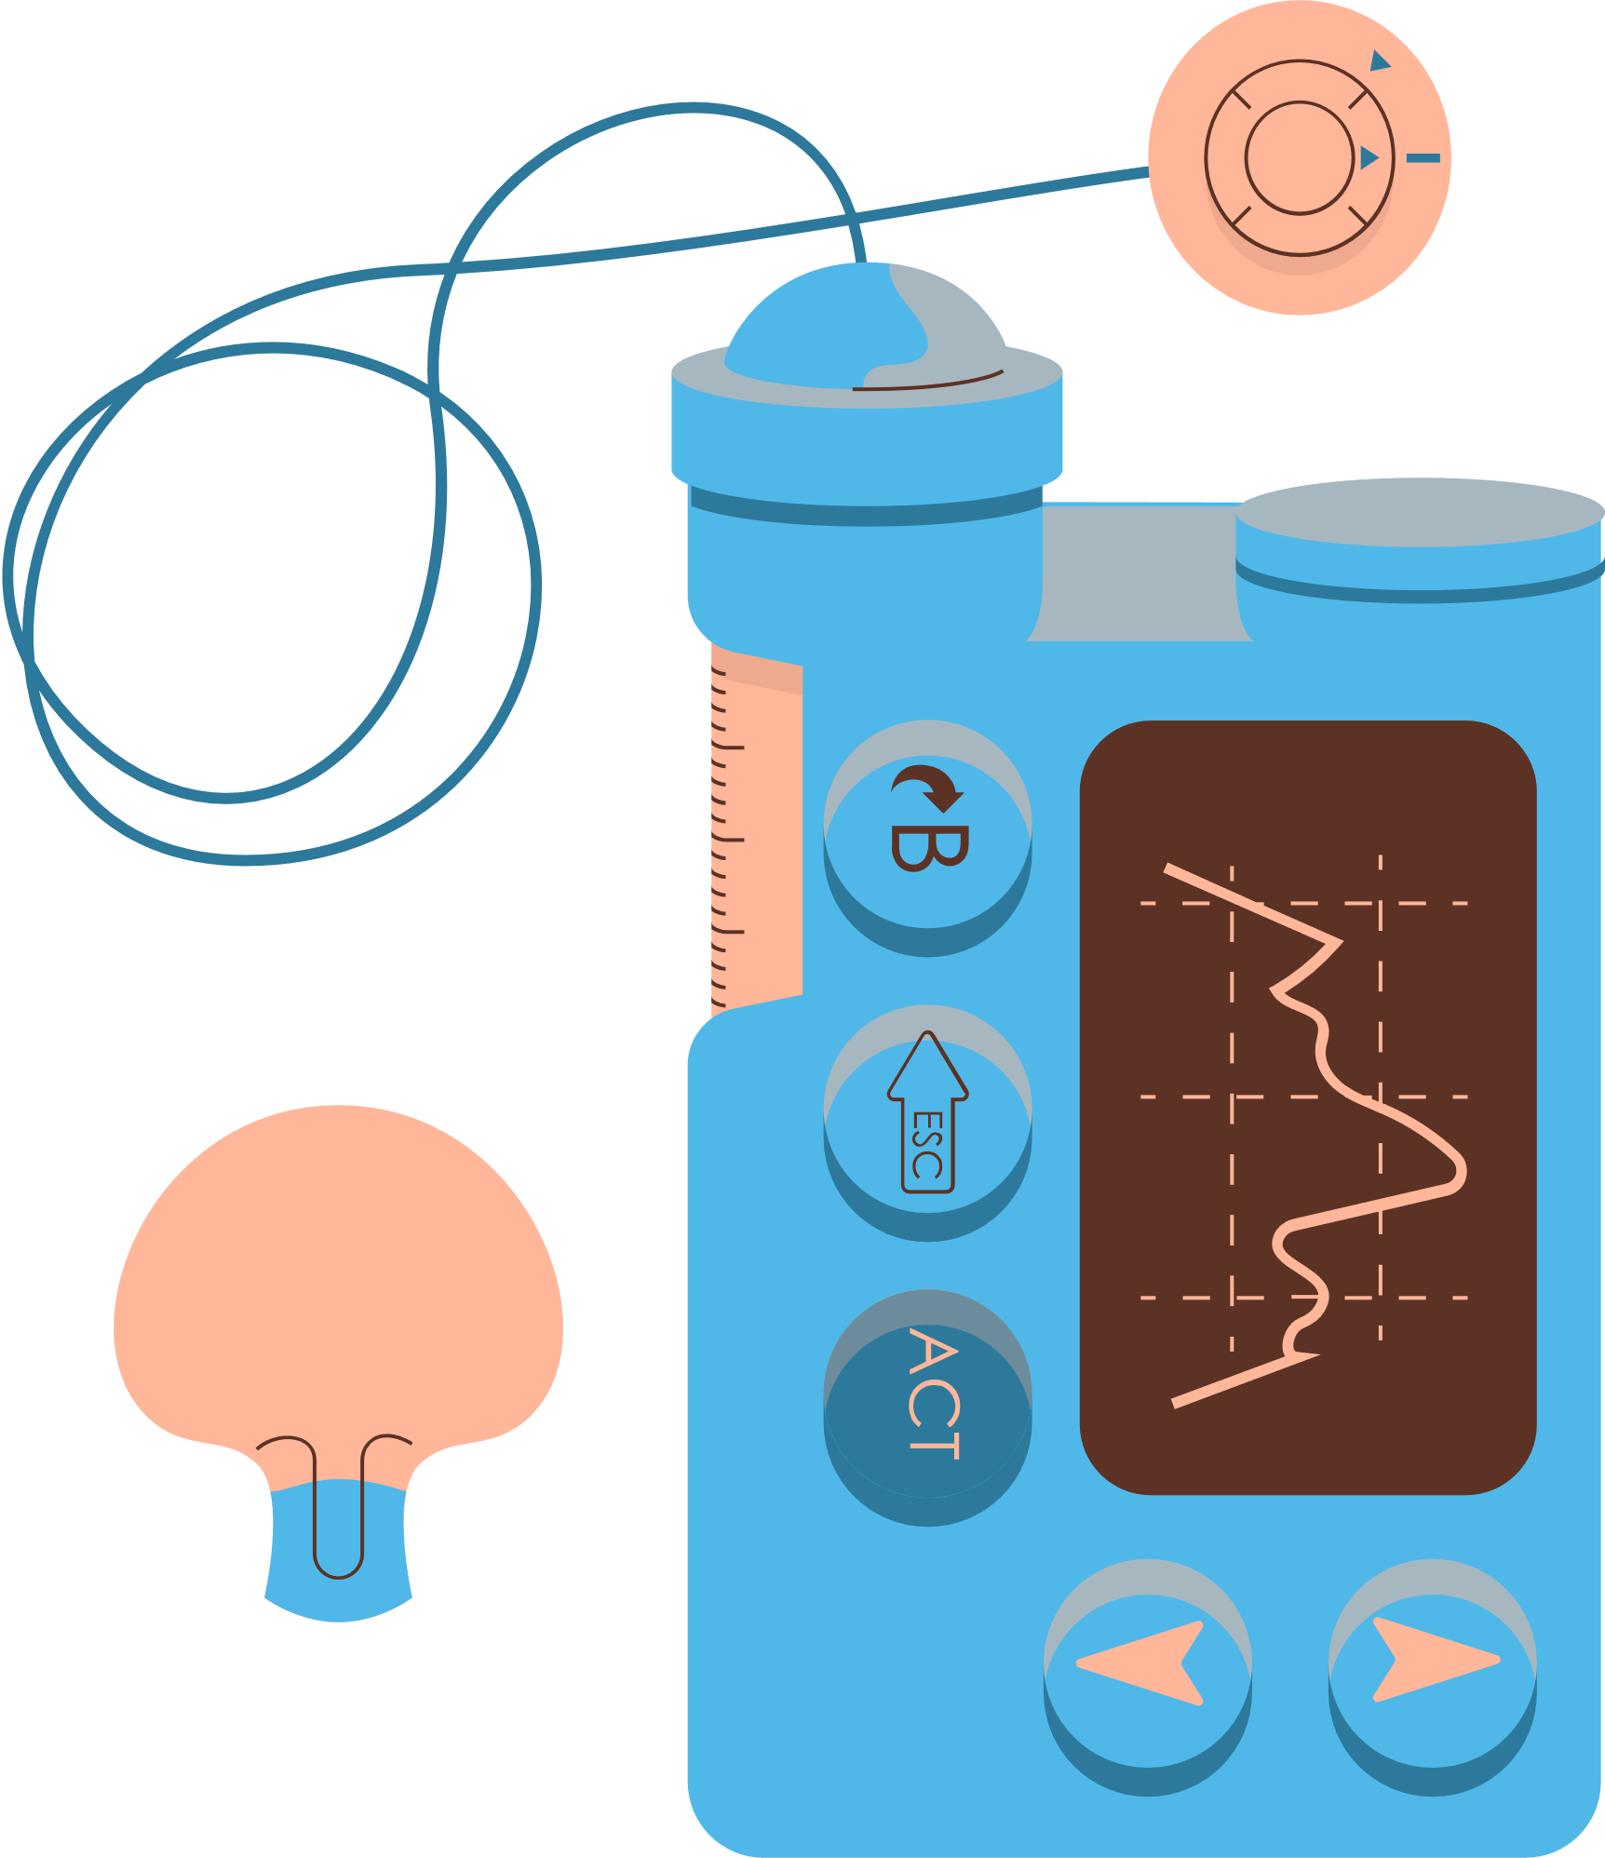
UPTP- UNIFIED PATIENT TREATMENT PLATFORM
Healthcare Project

Slide 2
IDEA OVERVIEW
A system designed to bring together patient data and make it easily accessible to the doctors.
Provide quick access to medical records, and support better healthcare.
Allow patients to securely view their complete healthcare history, including records, prescriptions, tests, and treatment plans.
The Unified Patient Treatment Platform (UPTP) leverages patient data and symptom tracking to predict diseases that a patient might get in the future ,by using testing and training model.
Designing a website for a Unified Patient Treatment Platform (UPTP) using HTML and CSS involves creating a user-friendly and informative interface.

Slide 3
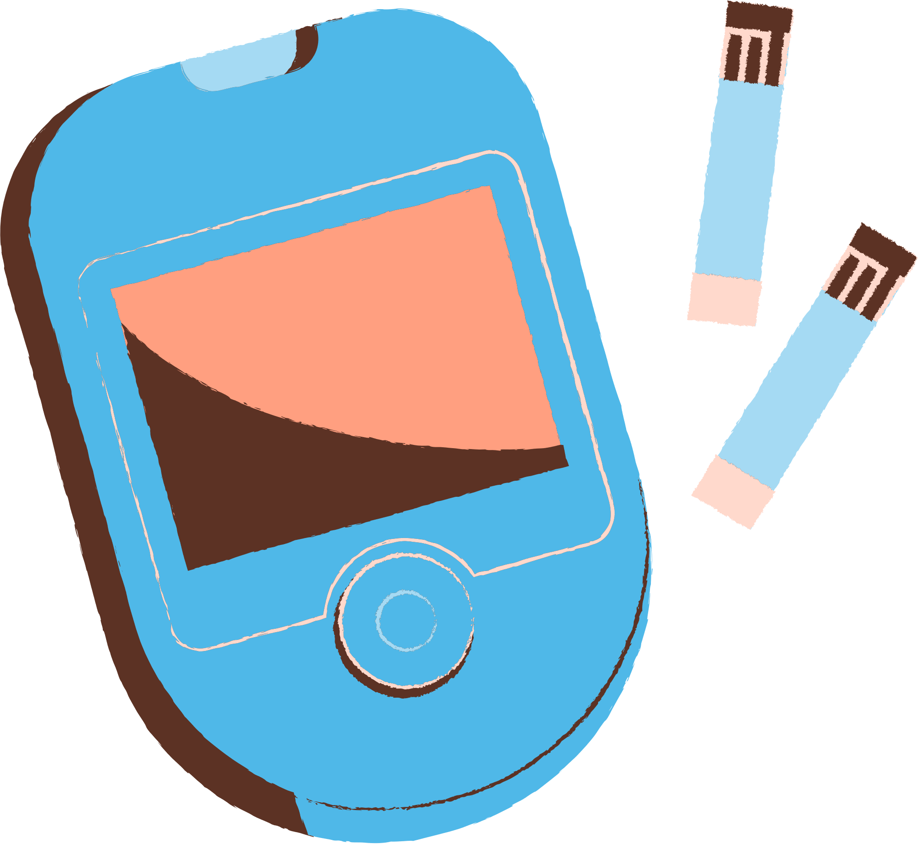
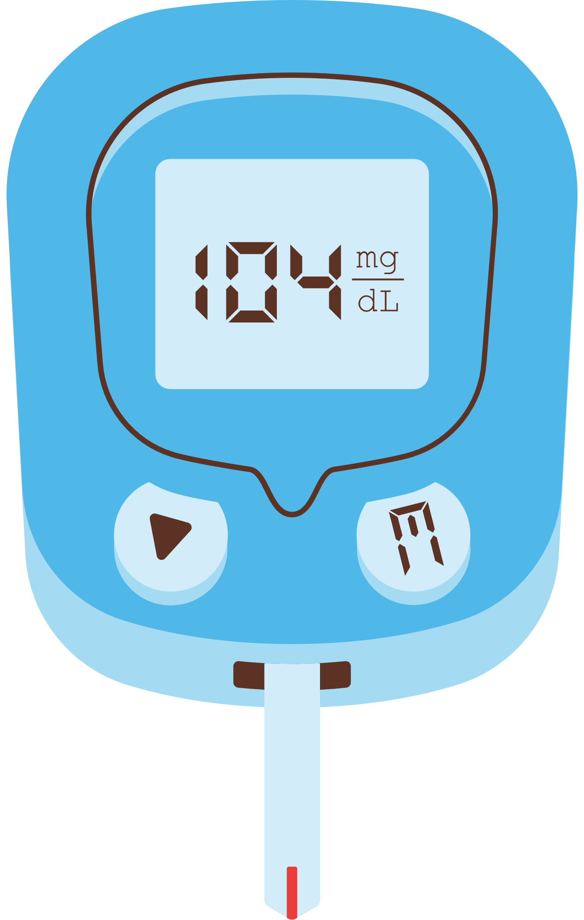
MARKET PROSPECTS
Preventive Healthcare
Healthcare Cost Reduction
Remote monitoring and Telemedicine
Pharmaceutical and Clinical Research
Global Reach
Technological Advancements

Slide 4
FUTURE SCOPE
There are a wide range of future scopes and applications for this project. A few of them are:
The project can be extended to predict multiple diseases or conditions simultaneously.
Remote monitoring of patients can be done, for example, wearable devices can be used to continuously collect data and send it to the prototype for analysis.
Personalized medicine/treatment can be provided for patients, by considering the individual characteristics, such as genetic information, past medical history etc.
This project model can be integrated with electronic health records, allowing for real-time patient data updates.

Slide 5


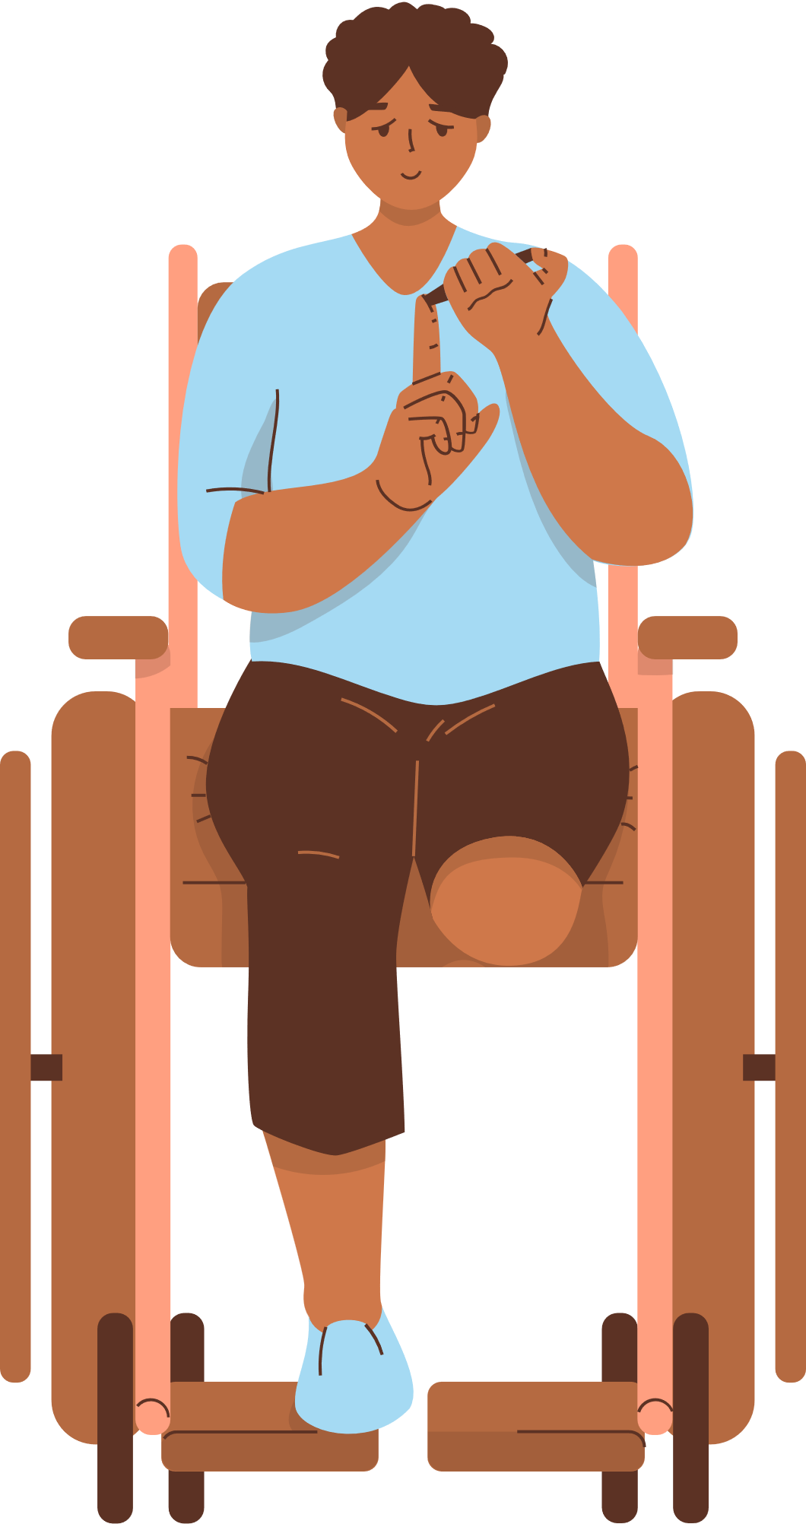
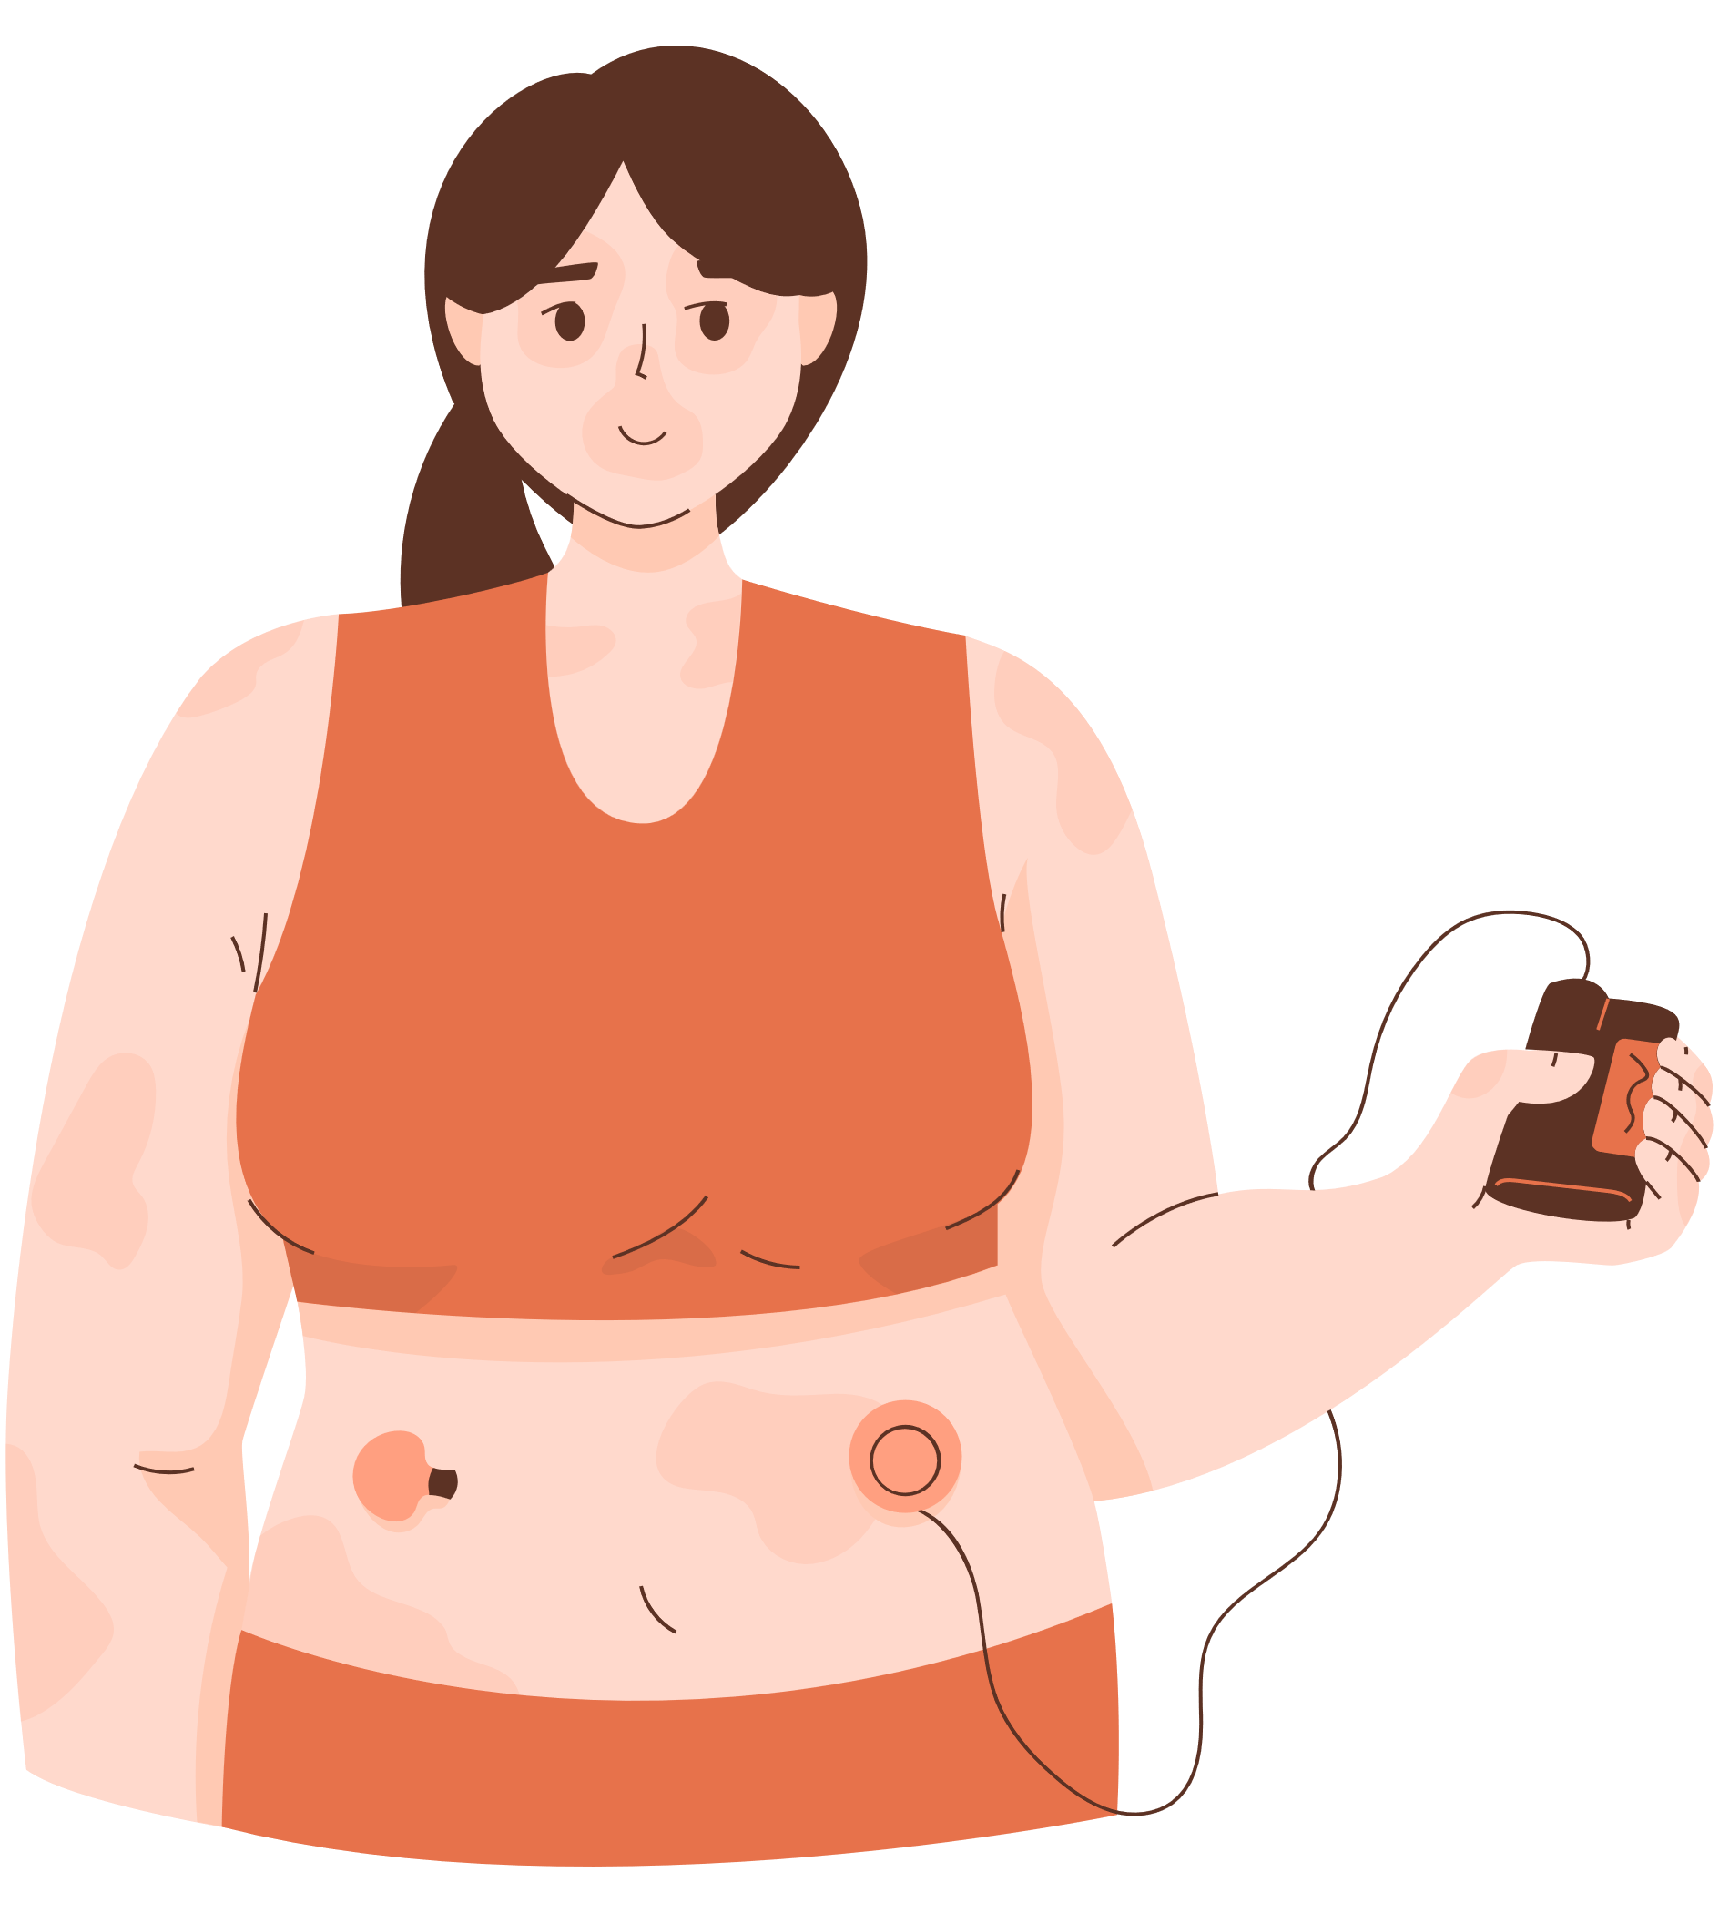
TECHNICAL OVERVIEW
We will be using:
Django for technical framework
Python for programming
Datasets

Slide 6
EXECUTION
https://github.com/ShaluDeen/UPTP

Slide 7
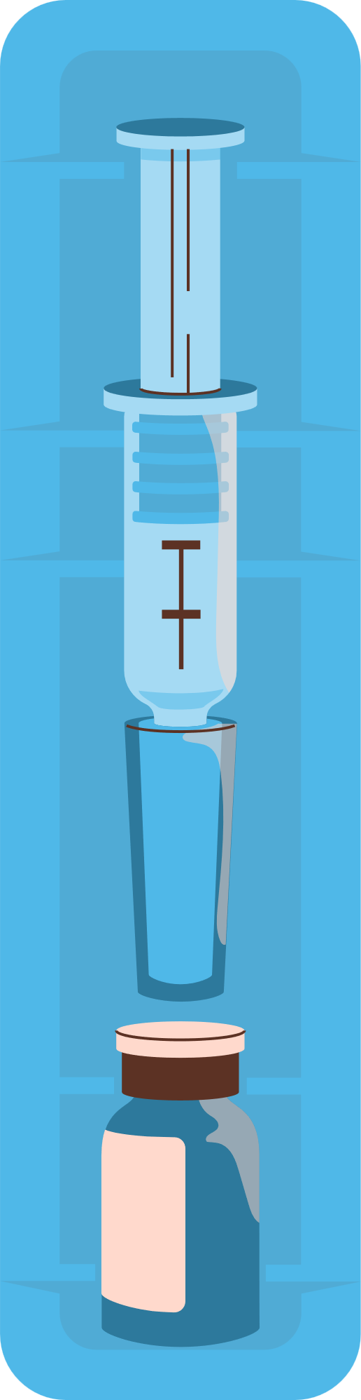
THANK YOU!
Presented by: The Spartans

